Slide 1
GoodBooks – 10k

Slide 2
About the dataset
Contains ratings for ten thousand popular books
Ratings go from one to five
Both book IDs and user IDs are contiguous. For books, they are 1-10000, for users, 1-53424
Lets look at the contents

Slide 3
Our Analysis
Part 1 – Explore the data
What is the distribution of ratings?
What is the distribution of mean user ratings?
What is the number of ratings per book?
How is the genres of the books distributed?
What are the top 10 rated books?
What are the top 10 popular books?
What influences a book’s rating?
Is sequel better than original?
And many more…
Part 2 – Build Recommender System Model

Slide 4
Part 1 – Data Exploration
Read the data
Load essential libraries

Slide 5
Clean the data
For some combinations of user and book there are multiple ratings, while in theory there should only be one
For the collaborative filtering in part 2 it is better to have more ratings per user. So I decided to remove users who have rated fewer than 3 books.

Slide 6
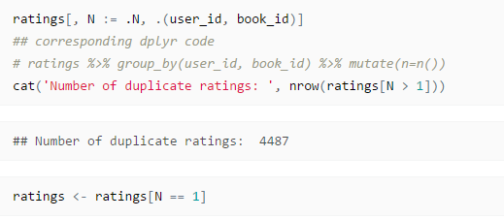
Clean the data
Remove the duplicate ratings

Slide 7
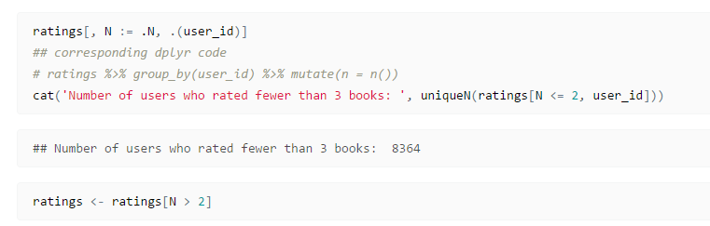
Clean the data
Let’s remove users who rated fewer than 3 books

Slide 8
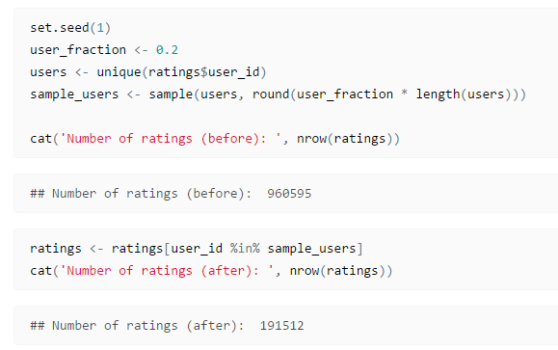
Select a subset of users
To reduce calculation times select only a subset of users. (e.g., 20%)

Slide 9
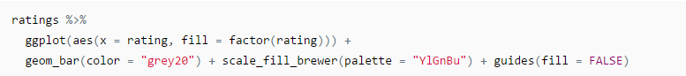
Data Exploration
What is the distribution of ratings?

Slide 10
Number of ratings per user

Slide 11
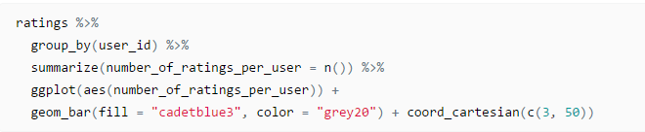
Number of ratings per user

Slide 12
Distribution of mean user ratings

Slide 13
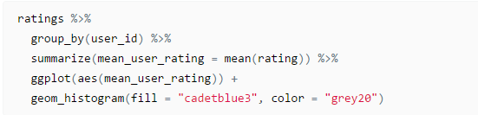
Distribution of mean user ratings

Slide 14
Number of ratings per book

Slide 15
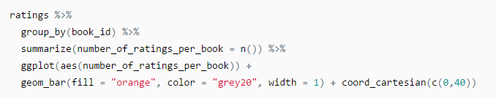
Number of ratings per book

Slide 16
Distribution of mean book ratings

Slide 17
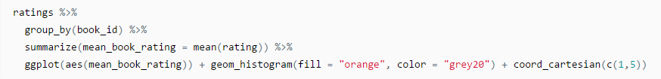
Distribution of mean book ratings

Slide 18
Distribution of Genres
Extracting the genres of the books is not trivial since users assign self-chosen tags to books, which may or may not be the same as genres defined by goodreads.
As a pragmatic way lets chose only the tags the match those provided by goodbooks.

Slide 19
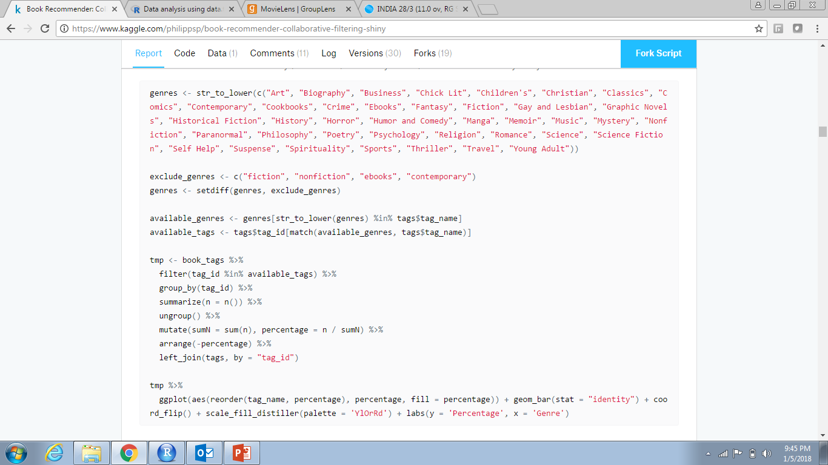
Distribution of Genres

Slide 20
Different languages
Number of books by English and Non-English languages

Slide 21
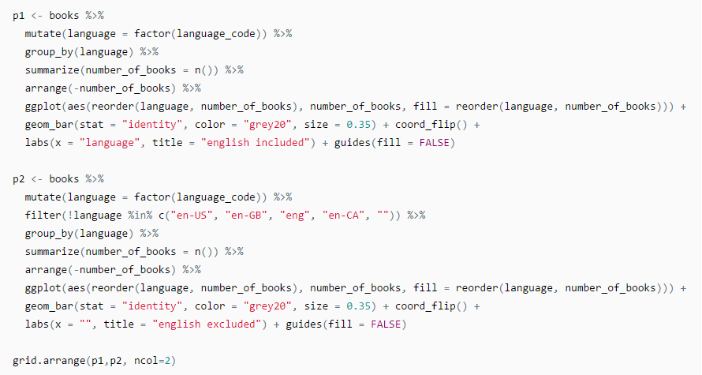
Different languages

Slide 22
Top 10 rated books
Top 10 books with highest average rating

Slide 23
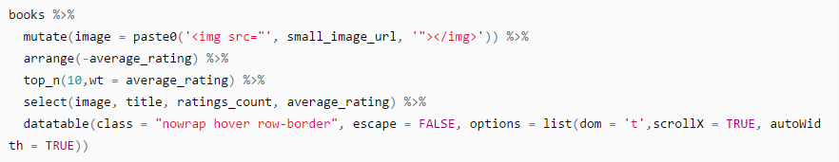
Top 10 rated books

Slide 24
Top 10 popular books
Top 10 books with the most ratings_count

Slide 25
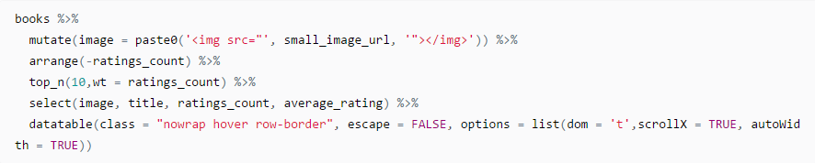
Top 10 popular books

Slide 26
What influences a book’s rating?
Lets see if we can find any associations of features with a book’s rating
Let’s first plot the correlation matrix between the books average_rating and some variables.

Slide 27
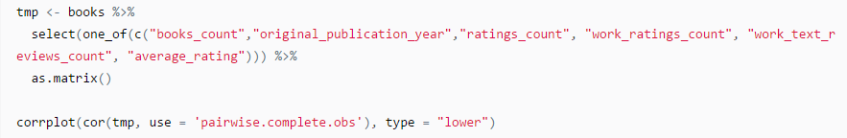
What influences a book’s rating?

Slide 28
Is there a relationship between the number of ratings and the average rating?
Is it that once a book becomes popular it gets better ratings?
Lets see the correlation of average_rating and ratings_count

Slide 29
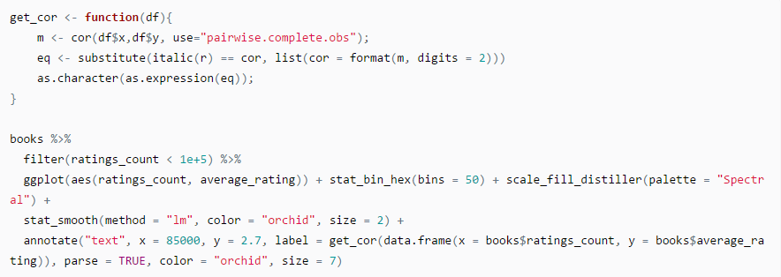
Is there a relationship between the number of ratings and the average rating?

Slide 30
Multiple editions of each book
The dataset contains information about how many editions of a book are available in book_count
Does more edition mean better rating?
Lets plot average_rating vs books_count

Slide 31
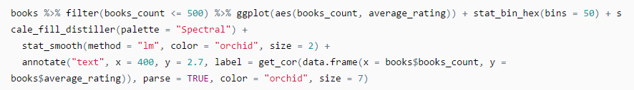
Multiple editions of each book

Slide 32
Do frequent raters rate differently?
Is it that frequent raters tend to give lower ratings to books (maybe they are/become more critical the more they read and rate)?
Lets plot mean_rating vs number_of_rated_books

Slide 33
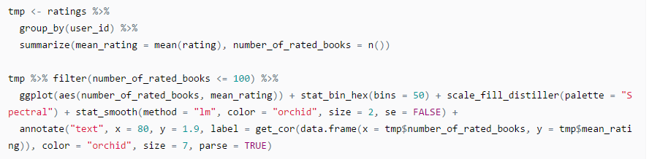
Do frequent raters rate differently?

Slide 34
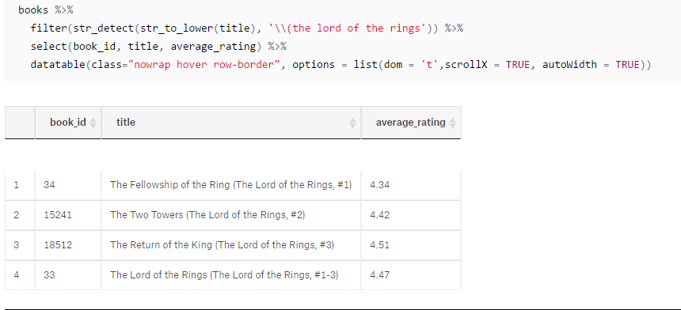
Series of books
The data contains information in the title column about whether a certain book is part of a series (e.g. the Lord of the Rings trilogy)

Slide 35
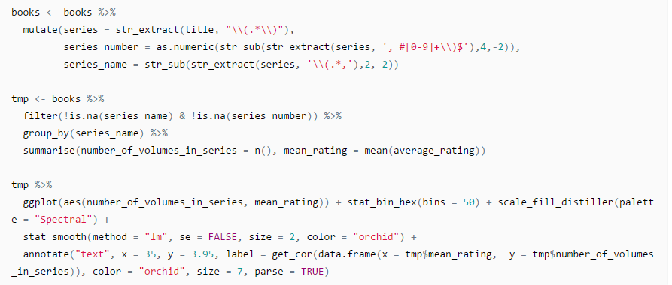
Series of books

Slide 36
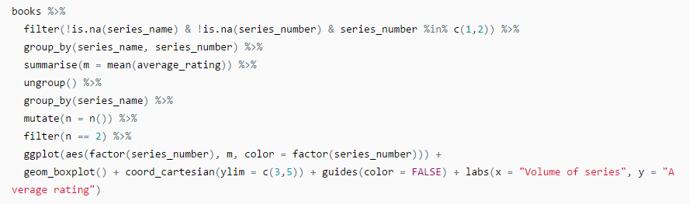
Is the sequel better than the original?
Lets plot average_rating vs volume (1 & 2 only) of series

Slide 37
How long should a title be?
If you are an author, one of the most important choices is the title of a book. Of course the content of the title is important. However, it might also matter how long the title is.
Lets therefore plot the average rating as a function of the length of the title

Slide 38
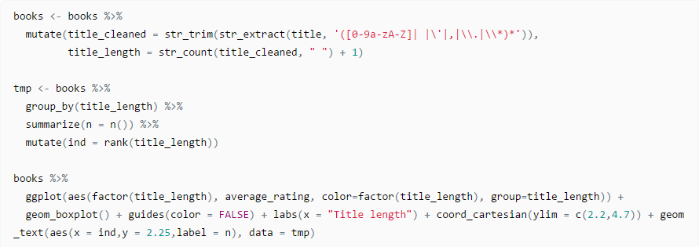
How long should a title be?

Slide 39
Does having a subtitle improve the book’s rating?
Do books that have a subtitle get rated higher than books without a subtitle?

Slide 40
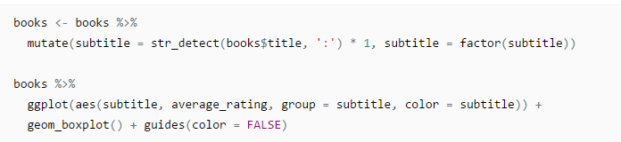
Does having a subtitle improve the book’s rating?

Slide 41
Does the number of authors matter?
“Too many cooks spoil the broth”…is it true here?

Slide 42
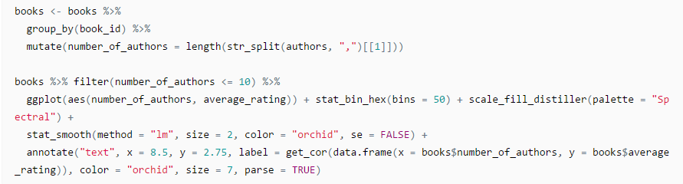
Does the number of authors matter?

Slide 43
Summary Part 1
So what do we conclude?

Slide 44
Part 2 – Modelling for Recommendation Engine
Collaborative Filtering:
Step 1 - identify other users similar to the current user in terms of their ratings on the same set of books
Step 2 - If you found those similar users you take their average rating of books the current user has not yet read …
Step 3 - … and recommend those books with the highest average rating to him
However, before we can do that we have to restructure our data. For collaborative filtering data are usually structured that each row corresponds to a user and each column corresponds to a book

Slide 45
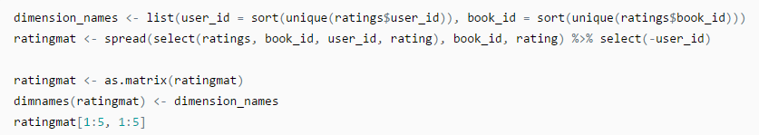
Restructure the Data

Slide 46
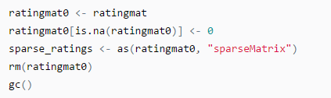
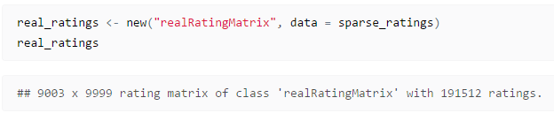
Using Recommenderlab
Recommenderlab is a R-package that provides the infrastructure to evaluate and compare several algortihms
First represent “ratingmat” is sparse format in order to save memory
Recommenderlab uses as special variant of a sparse matrices, so we convert to this class

